Slide 1

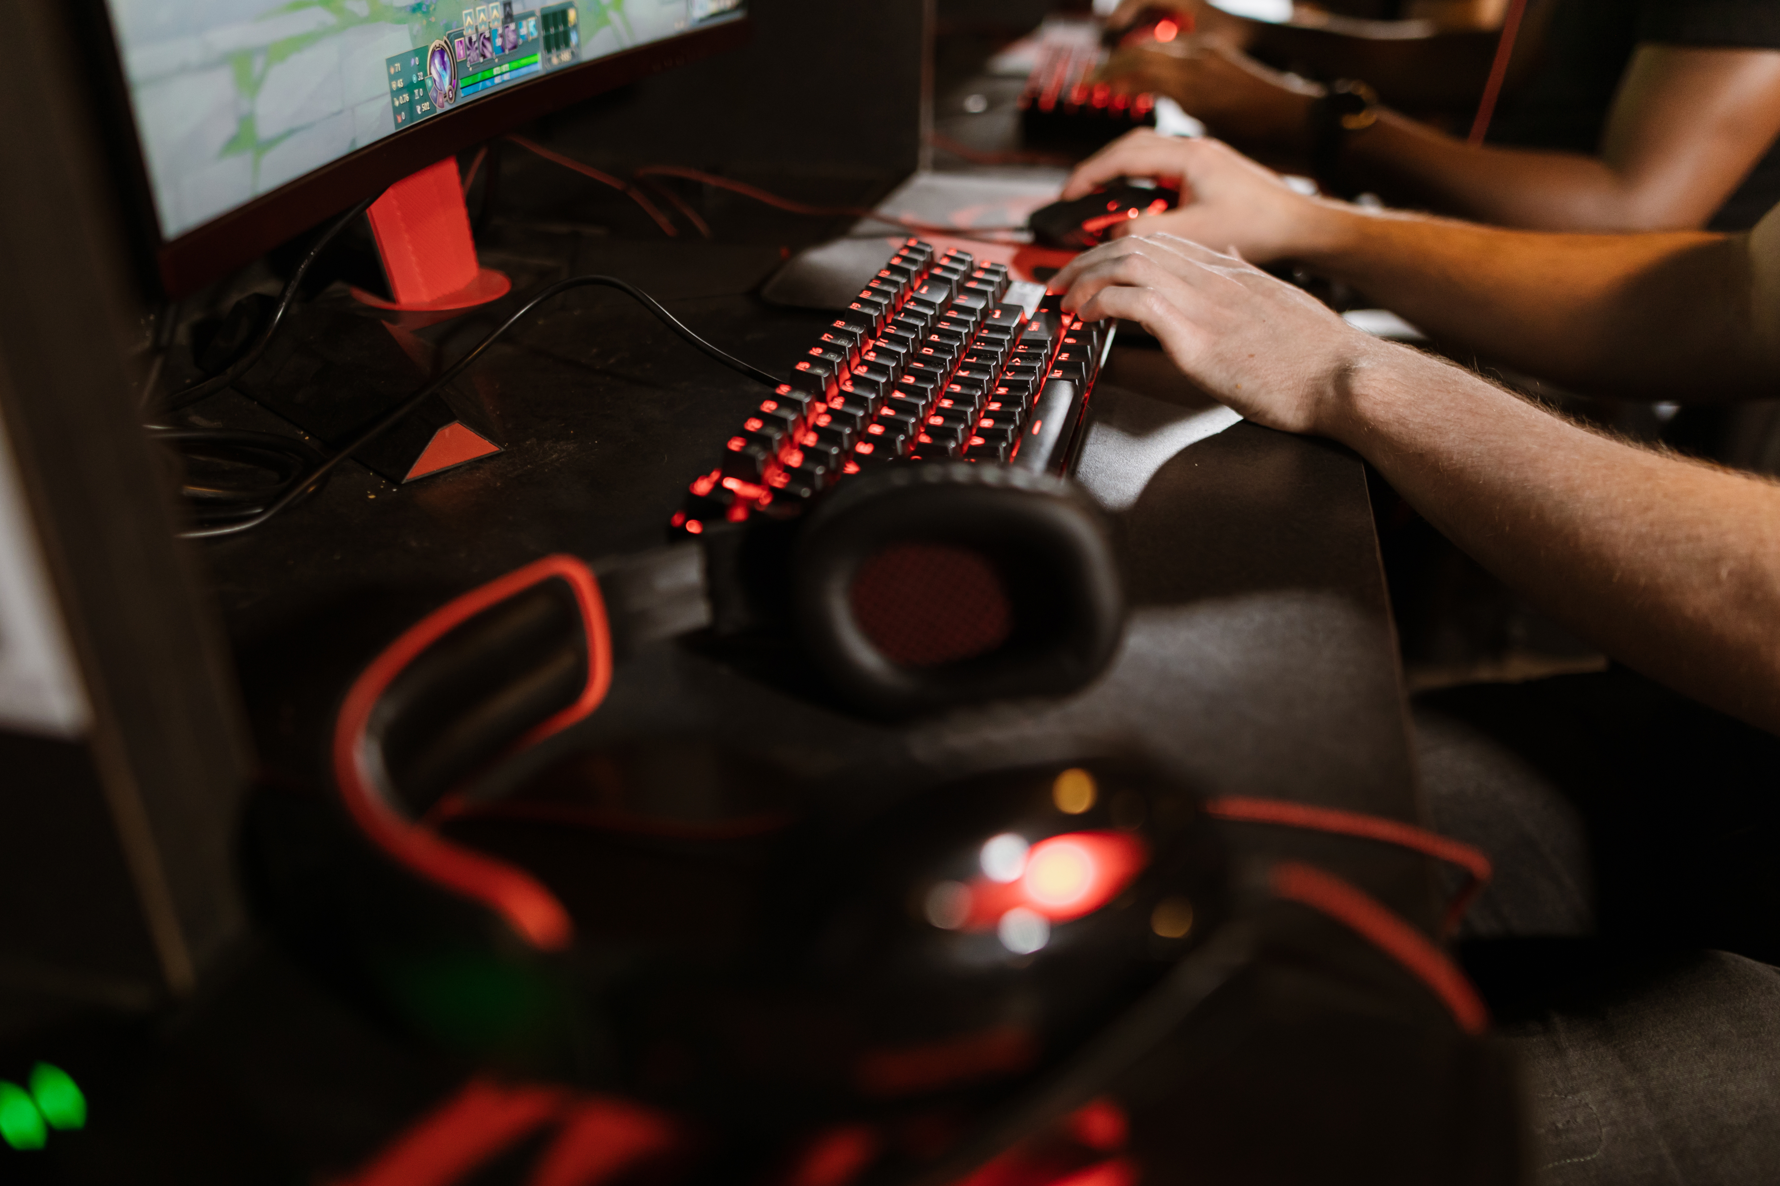
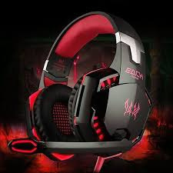

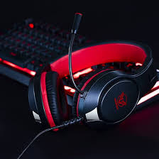
FUSION
AUDIO
GAMING HEADPHONES

Slide 2
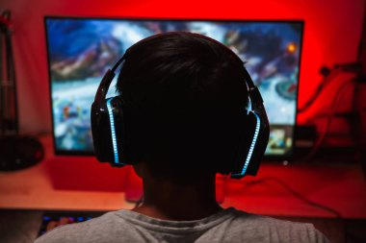
WHY
GAMING HEADSETS
As a group made up of gamers and enthusiasts of gaming equipment, we are genuinely passionate about this product. We believe our interest in high-quality sound, immersive gaming experiences, and cutting-edge technology will drive our dedication to marketing efforts.

Slide 3
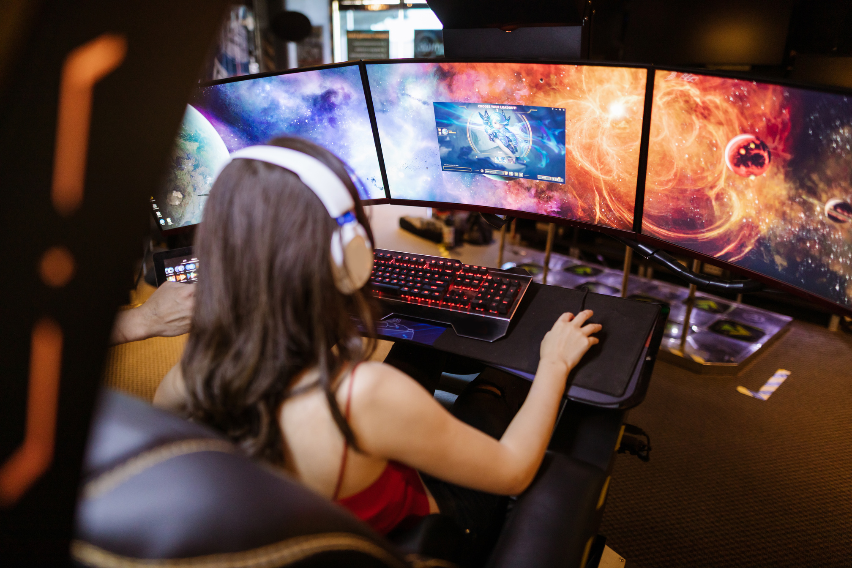
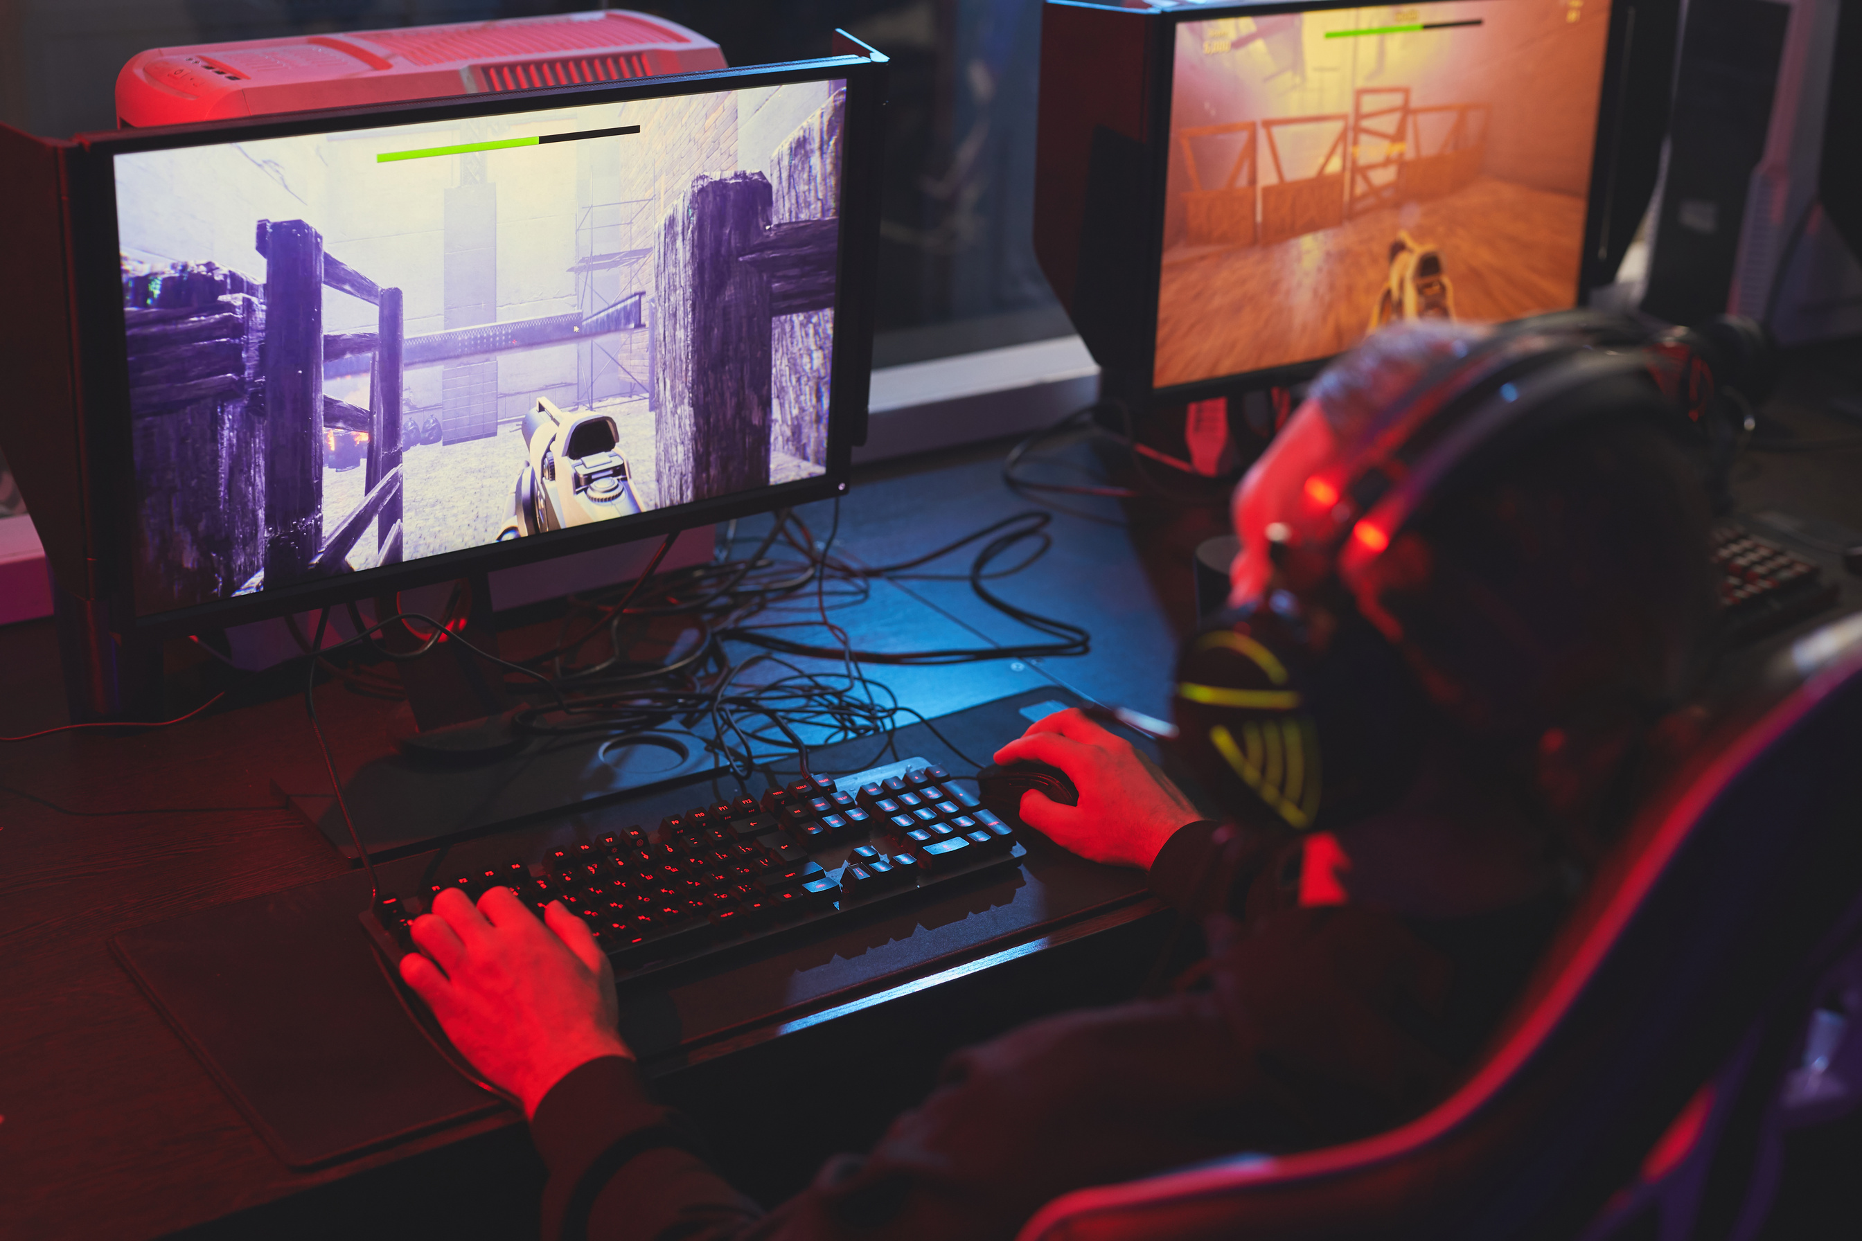
TARGET
MARKET
Primarily males and females aged 16-35, students, young professionals,gaming enthusiasts, and music lovers. Individuals who value premium sound quality, are tech-savvy, and have a passion for gaming or streaming. Gamers who invest in gaming accessories, participate in online gaming communities, and follow gaming trends.

Slide 4
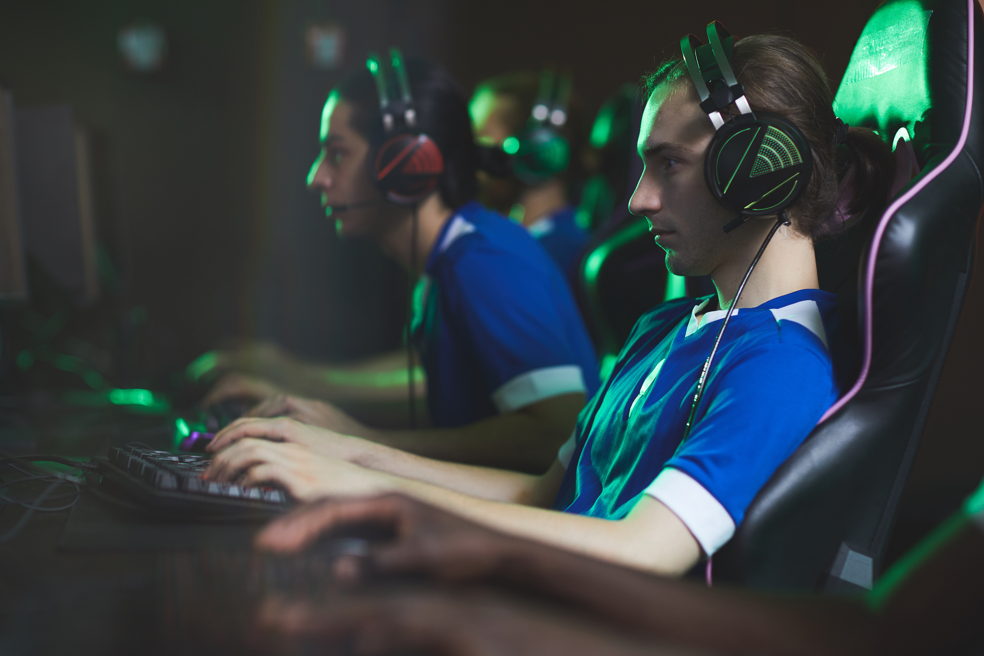
MARKET
POTENTIAL
The global gaming headset market is experiencing significant growth, with a projected compound annual growth rate (CAGR) of 7.2% from 2023 to 2028. This growth is driven by demand from both casual and professional gamers, making it a promising niche with substantial market potential.
In Uganda, the gaming community has grown significantly due to increased access to affordable internet and mobile devices. Urban areas like Kampala have seen the rise of gaming hubs, esports tournaments, and social media communities fostering connections among gamers. Hence strong growth potential for gaming accessories like headphones.

Slide 5
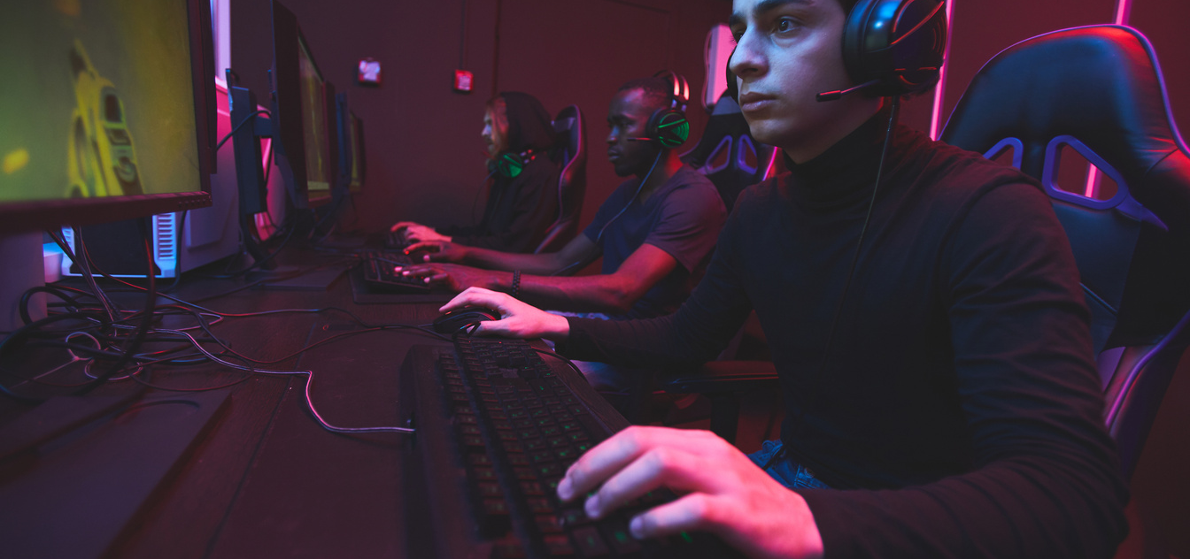
UNIQUE SELLING
PREPOSITION
The unique selling proposition for gaming headphones is their combination of ergonomic design, superior sound quality (including 7.1 surround sound), and affordability compared to competitors.

Slide 6



CHANNEL
SELECTION
gaming communities
discord
Reddit
and gaming centers
online stores
jumia
jiji
amazon
social media
tiktok
facebook
instagram

Slide 7



COMP
ETITION
Opportunities:
Supply from affordable headphone makers such as Topway EM enterprise
We can capitalize on affordability, premium sound features, and multi-platform support to differentiate ourselves from our competitors.
Weaknesses:
Many competitors’ products are expensive, lack ergonomic designs, or fail to offer universal compatibility.
Strengths:
Established brands like Logitech, Razer, and SteelSeries have strong brand recognition and loyal customer bases.

Slide 8

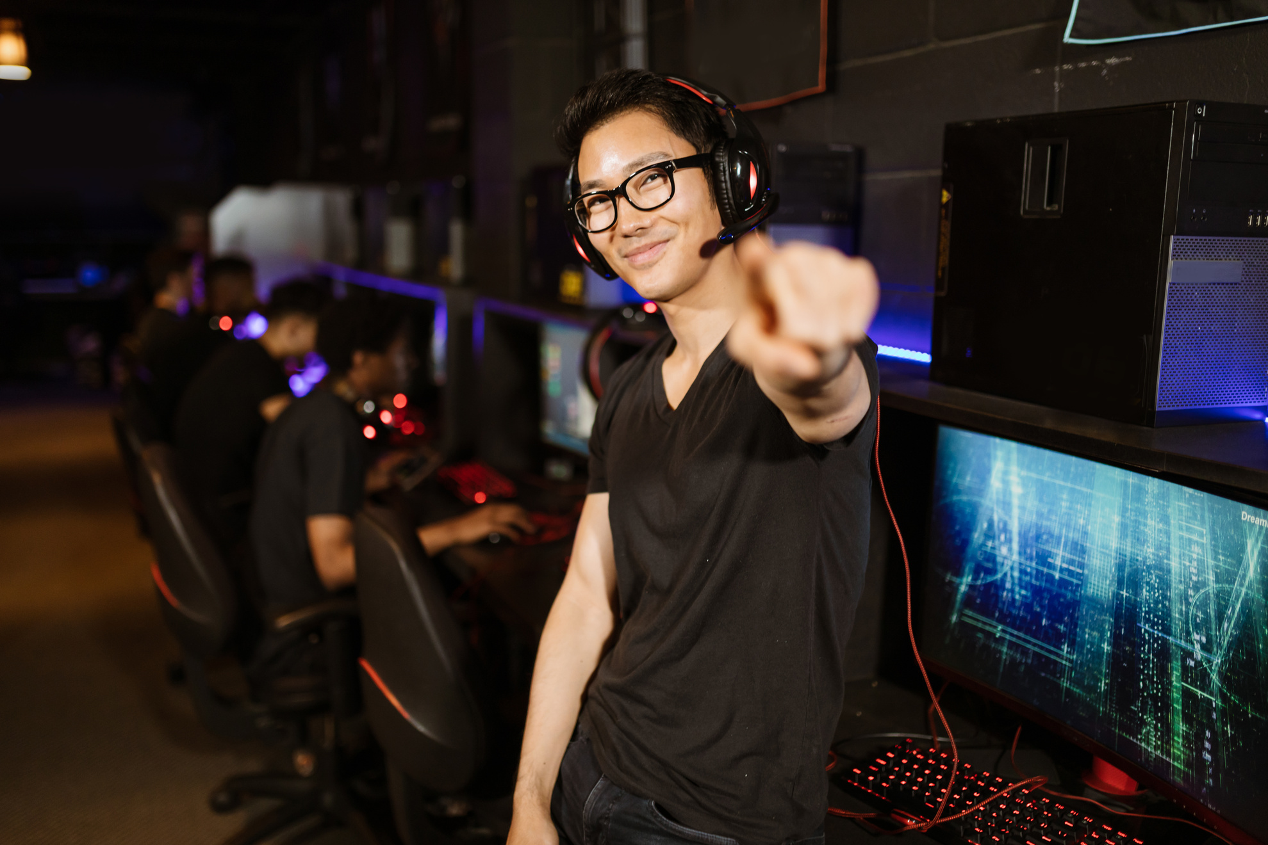
ALIGNMENT
WITH TRENDS
Gaming headphones align with current trends in the gaming industry, such as the rise of esports, immersive gaming experiences, and the demand for high-quality streaming equipment.

Slide 9
THANK
YOU

